Slide 1


M.Tech/MCA Program
Advanced Industry Integrated Programs
Jointly offered by University and LTIMindTree
Review II
Multi-Agent AI Travel Planner with Real-Time Guidance
Team Member
Kaviya V
M. Tech (Artificial Intelligence and Machine Learning)
VIT Vellore
Knowledge partner | Implementation partner

Slide 2
Multi-Agent AI Travel Planner with Real-Time Guidance
Introduction
Combines LLM intelligence with Google Maps precision.
Generates dynamic itineraries.
Recommends personalized points of interest.
Supports multilingual voice input.
Enables shareable trip links.

Slide 3
Multi-Agent AI Travel Planner with Real-Time Guidance
Objective
Personalizes itineraries using LLMs.
Integrates real-time geographic data.
Recommends diverse POIs.
Enables interactive map visualizations.
Supports shareable links and modular architecture.

Slide 4
Multi-Agent AI Travel Planner with Real-Time Guidance
Module name
User Interface & Interaction Layer:
Voice Input Processing.
User Interface Design & Display.
AI Planning & Optimization Engine:
AI-Based Itinerary Generation.
Cost Prediction via Machine Learning.
Real-Time Route Optimization.
Multilingual Translation Support.

Slide 5
Multi-Agent AI Travel Planner with Real-Time Guidance
Module name
Data Presentation & Export Module:
Dynamic Map Generation & Visualization.
Printable HTML Itinerary.
Shareable Trip Link Creation.
Data Persistence & Storage Layer:
Database for Saving & Loading Trip Data.
Admin & Analytics Dashboard:
Performance Monitoring & User Analytics.
AI Model Effectiveness Reporting.

Slide 6
Multi-Agent AI Travel Planner with Real-Time Guidance
Methodology/Modeling Plan
LLM + ML Integration:
Combines LLM for creative planning with LightGBM for cost prediction.
Synthetic Data Generation:
Uses LLM to generate training data for the cost model.
Predictive Modeling:
Employs LightGBM for high-performance cost estimation.

Slide 7
Multi-Agent AI Travel Planner with Real-Time Guidance
Methodology/Modeling Plan
Auto Hyperparameter Tuning:
Uses Optuna for optimal model configuration.
Real-Time API Integration:
Connects to Google Maps APIs for live traffic and routing.
User-in-the-Loop Workflow:
Interactive UI triggers all AI planning and optimization.
Continuous Monitoring:
Dashboard tracks AI performance and user engagement.

Slide 8
Multi-Agent AI Travel Planner with Real-Time Guidance
Data preprocessing & EDA
Feature Engineering: Extracted key features like start_city, end_city, budget_level, vehicle_type from LLM output.
Numerical Extraction: Parsed strings like "240 km", "4 hours" into numeric values using regex.
Categorical Encoding: Applied One-Hot Encoding (pd.get_dummies) for cities and vehicle types.
Feature Name Sanitization: Cleaned column names to remove special characters for LightGBM compatibility.
Data Cleaning: Dropped rows with missing target values (e.g., cost) to maintain dataset integrity.

Slide 9
Multi-Agent AI Travel Planner with Real-Time Guidance
Data preprocessing & EDA
KPI Monitoring: Defined metrics like Itinerary Helpful Score and AI Reliability Score.
User Intent Analysis: Used bar charts to highlight popular travel routes.
Cost Model Validation: Visualized cost distributions across budget levels using box plots.
User Persona Identification: Used scatter plots to reveal travel styles like Road Warriors vs Destination Explorers.

Slide 10
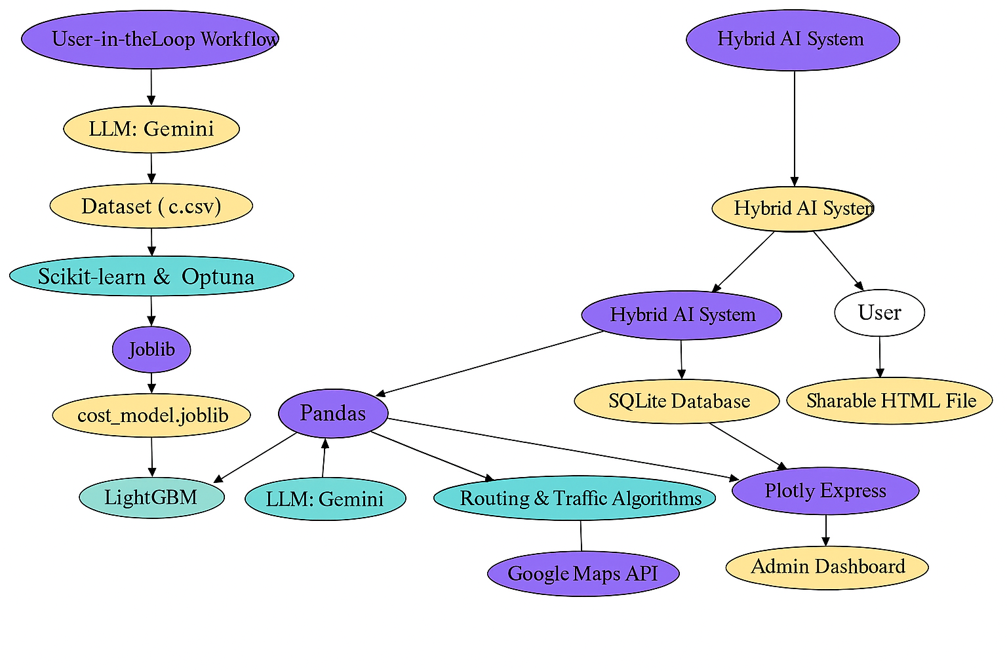
Multi-Agent AI Travel Planner with Real-Time Guidance
Approach/Algorithms/Tools

Slide 11
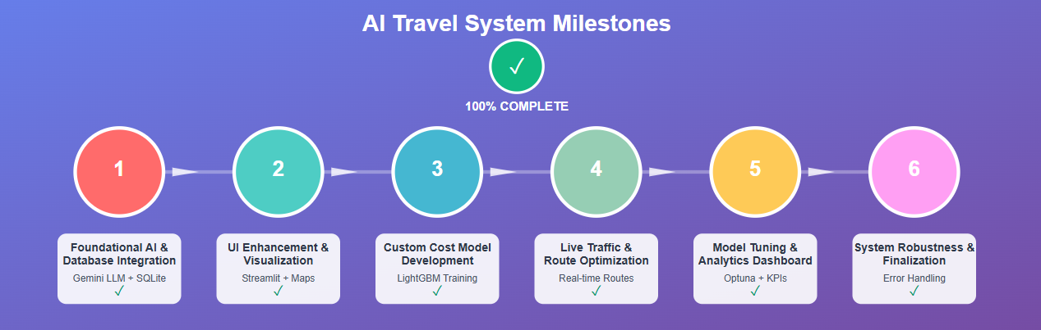
Multi-Agent AI Travel Planner with Real-Time Guidance
Project Plan/Milestone Progress

Slide 12
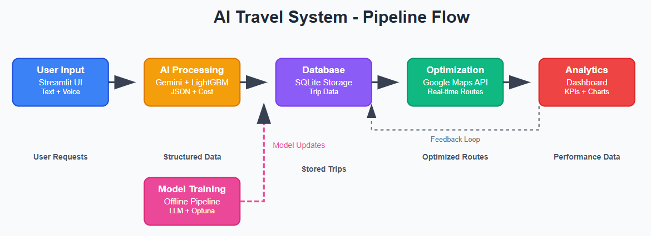
Multi-Agent AI Travel Planner with Real-Time Guidance
Pipeline Structure

